Slide 1
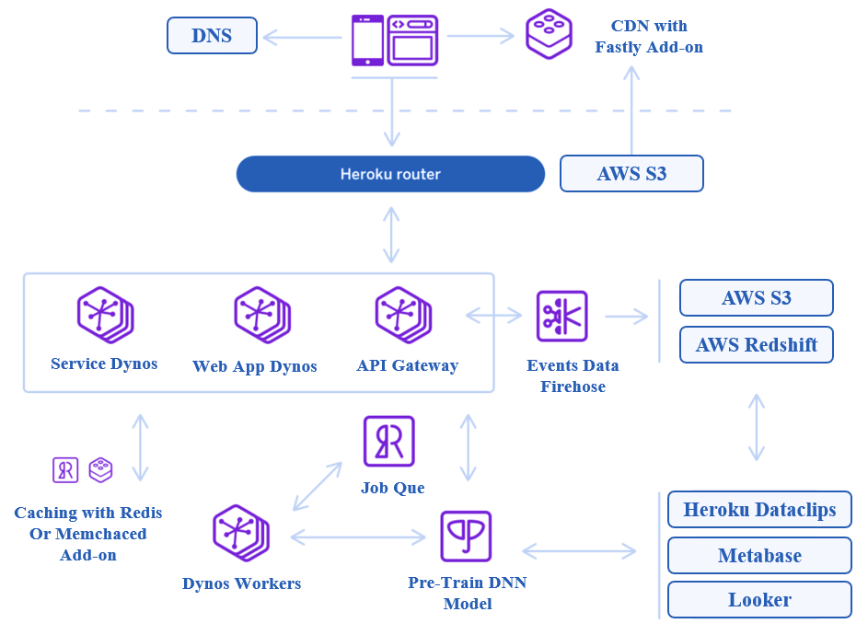

Slide 2
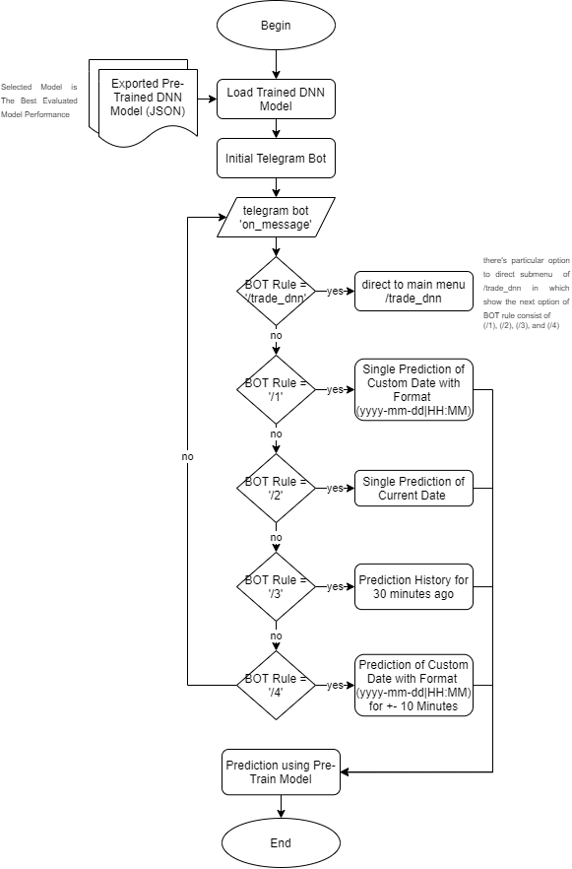
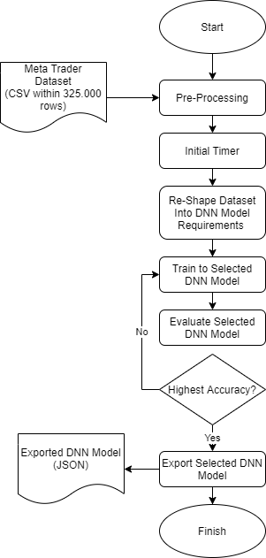

Slide 3















$$x_{1}$$
$$y_{1}$$
$$x_{2}$$
$$Act. Function 1$$
$$Act. Function n$$
$$σ$$
$$σ$$
$$y_{2}$$
$$x_{3}$$
…..
…..
$$y_{3}$$
$$Optimizer 1$$
$$Optimizer n$$
$$x_{4}$$
$$y_{4}$$
$$x_{5}$$

Slide 4
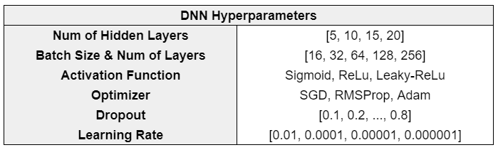

Slide 5
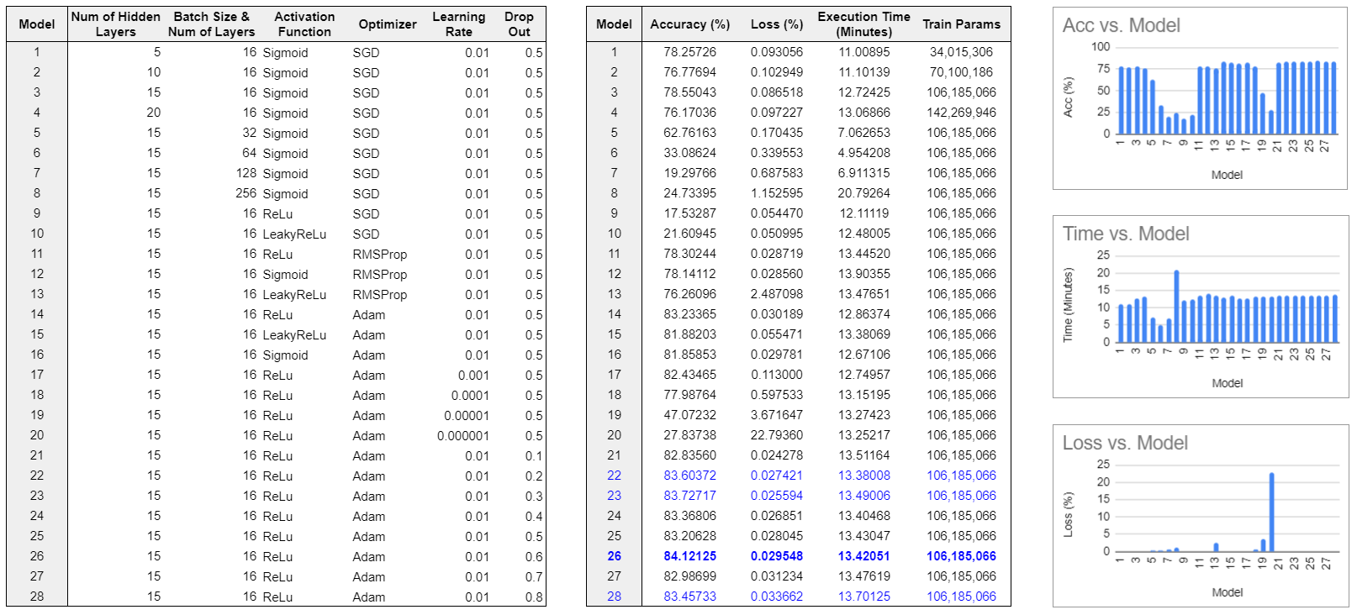

Slide 6
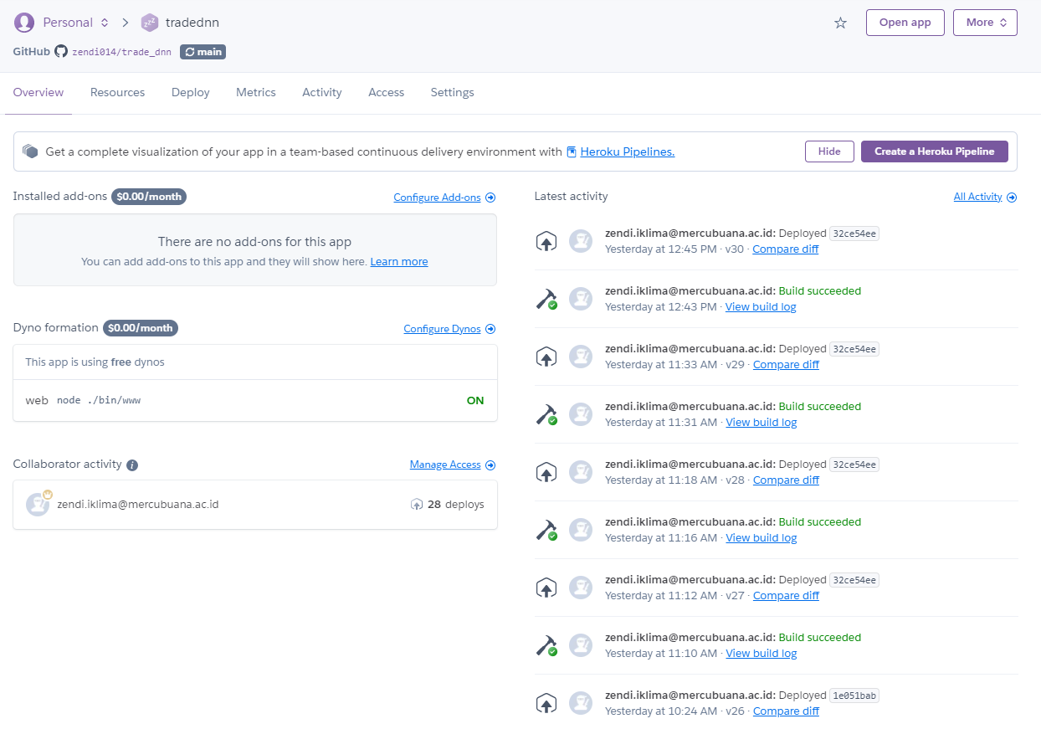

Slide 7
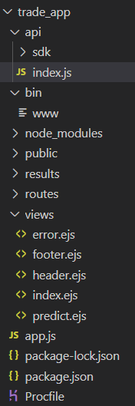
1. API Index
2. ExpressJS Config
3. Assets, Libraries, etc
4. Page Routers
5. Font-end Files
6. Main Executable File
7. Heroku Config FIle

Slide 8
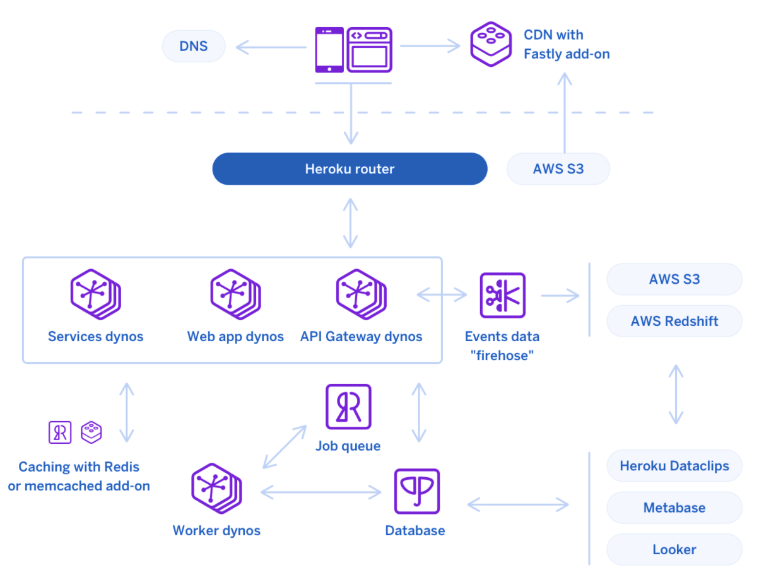
DNS
CDN with Fastly Add-on
AWS S3
AWS S3
Events Data
Firehose
AWS Redshift
Service Dynos
Web App Dynos
API Gateway
Job Que
Caching with Redis
Or Memchaced Add-on
Heroku Dataclips
Metabase
Dynos Workers
Pre-Train DNN Model
Looker
Notes:
https://binariks.com/blog/tools/express-js-mobile-app-development-pros-cons-developers/

